Slide 1
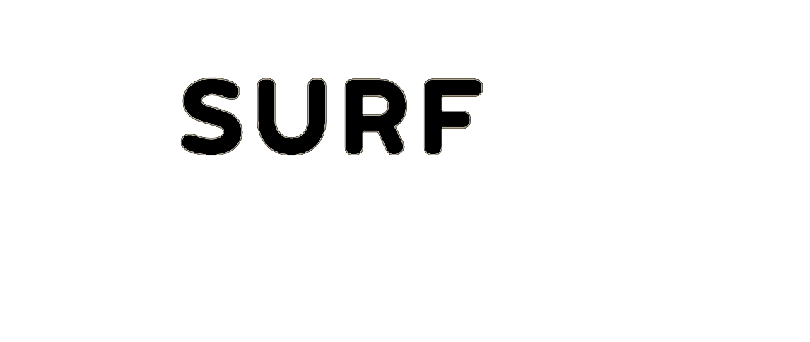
Deep Learning
Introduction Series
09/11/2022
Bryan Cardenas
Robert Jan Schlimbach
Caspar van leeuwen
High Performance Machine Learning Group

Slide 2
Prerequisites
Programming
R / Python
Statistics, Calculus
Machine Learning / Deep Learning
Parallel Computing

Slide 3

Plan for Today
01.
02.
General Introduction to ML
Neural Network
Convolutional Neural Networks
Profiling your Neural Networks
High Performance

Slide 4
Plan until Lunch
01.
DL Introduction Pytorch Intro
Hands-on: Fully connected
Recap Coffee Break
CNN Theory Hands-on: CNNs
LUNCH
02.
03.
04.
SURF

Slide 5
Machine Learning
01.

Slide 6
What ML is not:
Mimicking human intelligence
Robotics
Deep Learning

Slide 7
What ML is not:
Mimicking human intelligence
Robotics
Deep Learning
“
ML is the study of algorithms that can improve through experience and by the use of data. It is seen as part of Artificial Intelligence
~ Wikipedia

Slide 8
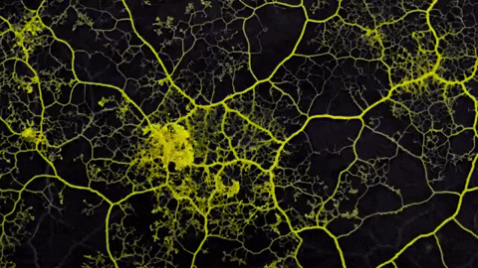
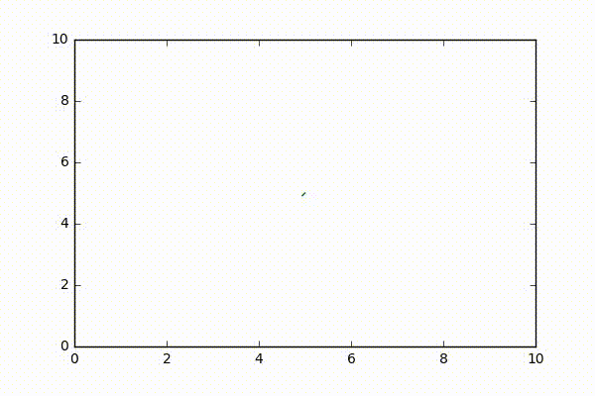
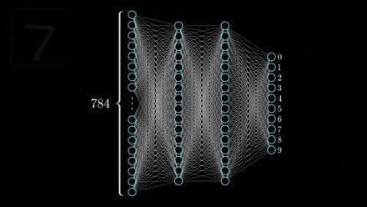
Artificial Intelligence
Having computers to exert
Intelligent behaviour

Slide 9
Artificial Intelligence
Machine Learning
Having computers to exert
Intelligent behaviour
Perform tasks without
Explicitly programmed
from data

Slide 10
Artificial Intelligence
Machine Learning
Deep Learning
Having computers to exert
Intelligent behaviour
Perform tasks without
Explicitly programmed
from data
Use deep neural networks

Slide 11
Why Machine Learning?
Think of a simple decision tree

Slide 12
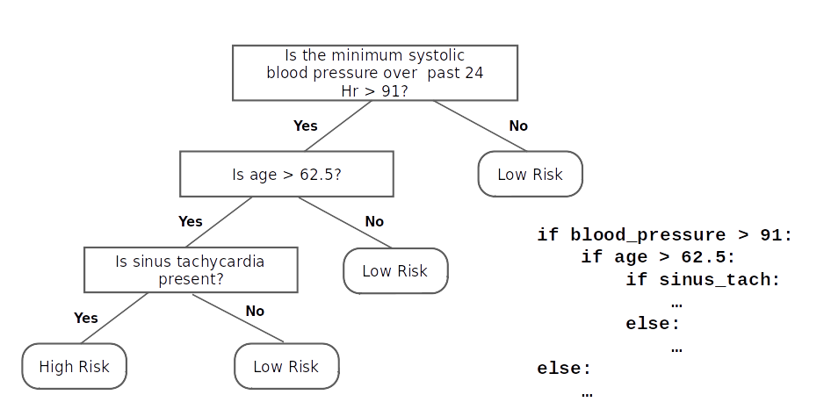
Why Machine Learning?
Think of a simple decision tree

Slide 13
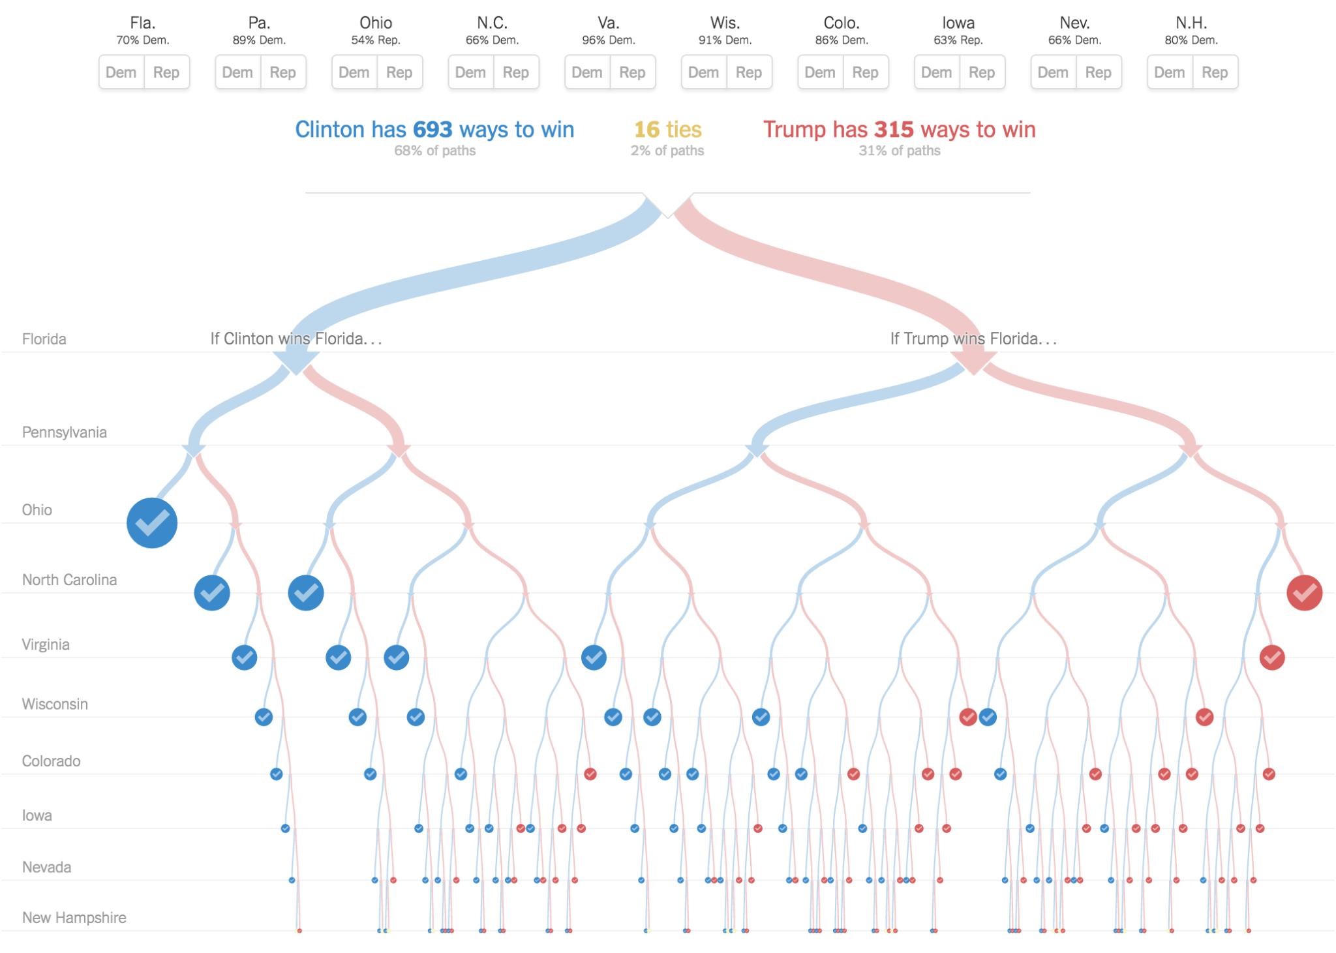
Why Machine Learning?
Think of a hard decision tree

Slide 14
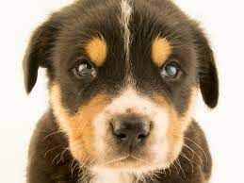
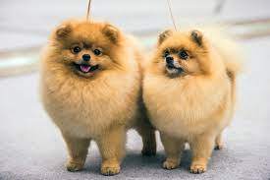

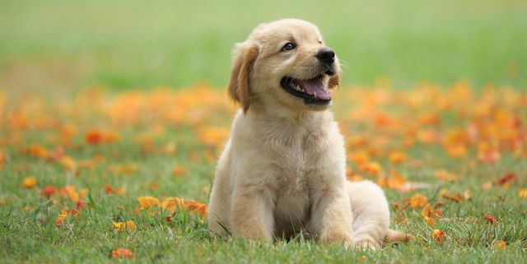

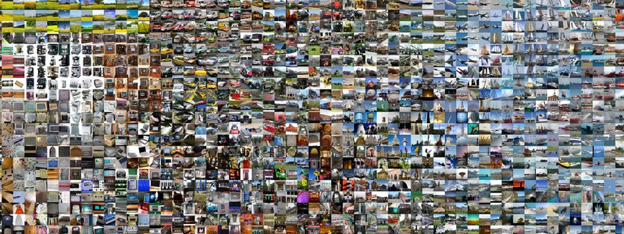
What is a dog?
Uncountable features that define a dog
We want an automatic way of learning these features
Driven by Data

Slide 15
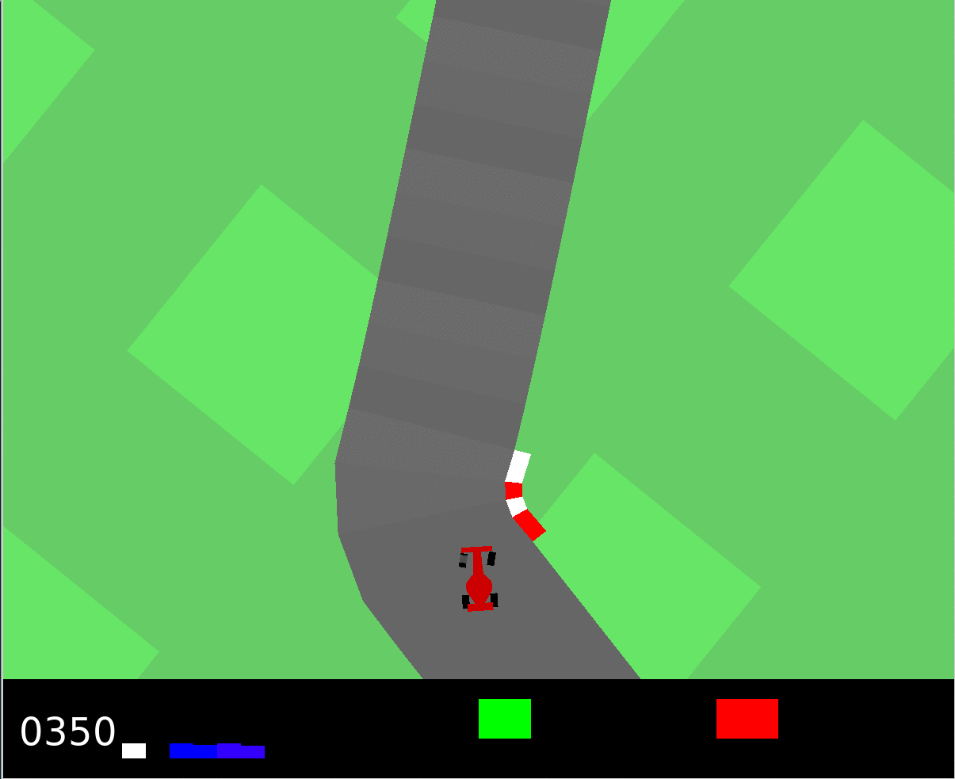
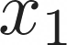
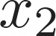
Categories of Machine Learning
01.
02.
03.
Supervised
Unsupervised
Reinforcement
Learn from labels
Regression, Classification
Detect Patterns in the data
Clustering, Dimensionality Reduction
Learn from the environment
Control, gaming

Slide 16
Neural Networks
02.

Slide 17
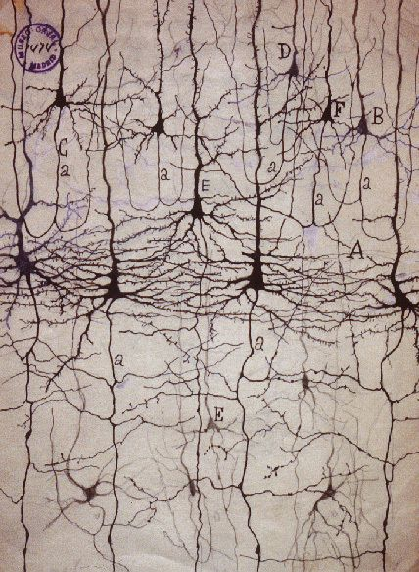
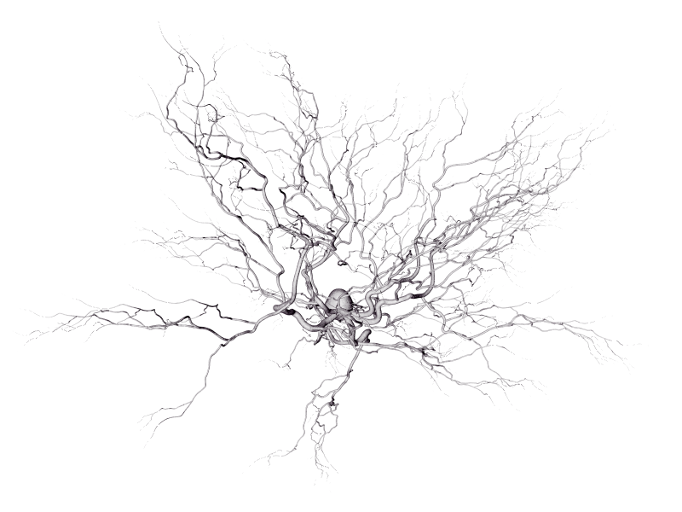
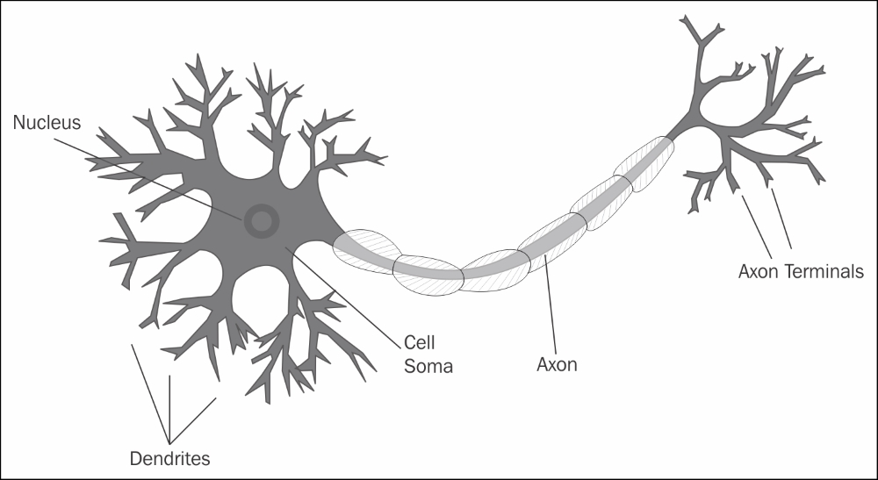
Biological Neuron
A neuron inhibits or excites a signal picked up from its receivers
Only fires if a threshold is reached and is connected to thousands of others.

Slide 18
Biological Neuron
A neuron inhibits or excites a signal picked up from its receivers
Only fires if a threshold is reached and is connected to thousands of others.
Humans have around 80 billion neurons and trillions of connections

Slide 19
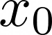
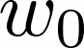
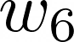
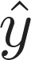
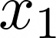
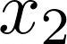
Anatomy of an Artificial Neural Network
Don’t model the biological neuron precisely

Slide 20
Anatomy of an Artificial Neural Network
Don’t model the biological neuron precisely
Inputs
Bias
Weights
Dot product
Non-linear activation

Slide 21
Anatomy of an Artificial Neural Network
Don’t model the biological neuron precisely
Use a (deep) neural network to approximate an unknown function
Inputs
Bias
Weights
Dot product
Non-linear activation

Slide 22
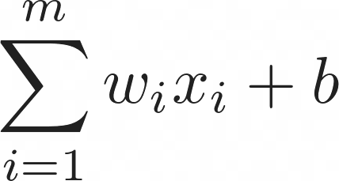
Anatomy of an Artificial Neural Network
Don’t model the biological neuron precisely
Use a (deep) neural network to approximate an unknown function
Inputs
Bias
Weights
Dot product
Non-linear activation

Slide 23

Anatomy of an Artificial Neural Network
Don’t model the biological neuron precisely
Use a (deep) neural network to approximate an unknown function
Inputs
Bias
Weights
Dot product
Non-linear activation

Slide 24
Anatomy of an Artificial Neural Network
Don’t model the biological neuron precisely
Use a (deep) neural network to approximate an unknown function
Inputs
Bias
Weights
Dot product
Non-linear activation
Easy to compose and easy to vectorize
Fits current compute paradigm

Slide 25
The Perceptron and Activation
Binary Classification Task
0

Slide 26
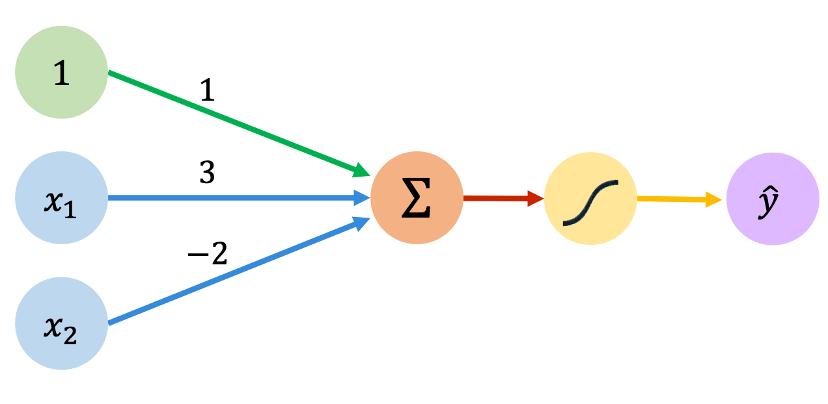
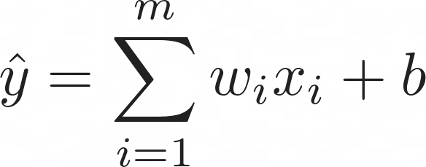
The Perceptron and Activation
Binary Classification Task
0

Slide 27
The Perceptron and Activation
Binary Classification Task
0

Slide 28
The Perceptron and Activation
Binary Classification Task
0

Slide 29
The Perceptron and Activation
Binary Classification Task
0

Slide 30
The Perceptron and Activation
Binary Classification Task
0

Slide 31
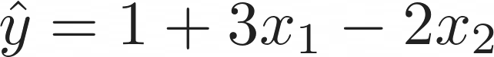
The Perceptron and Activation
Binary Classification Task
0

Slide 32
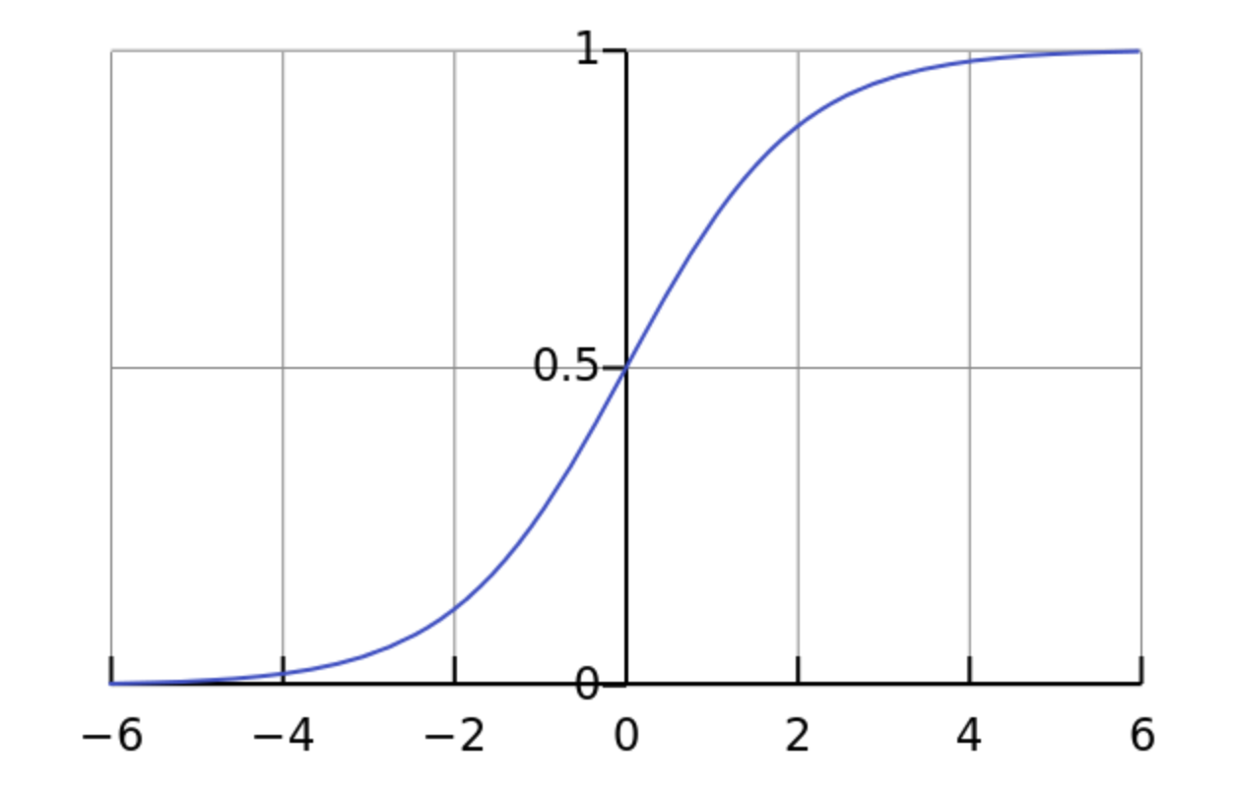
The Perceptron and Activation
Binary Classification Task
Sigmoid
0

Slide 33
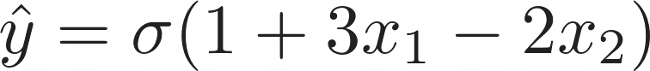
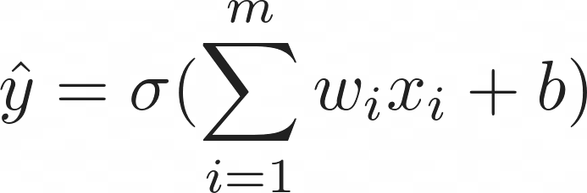
The Perceptron and Activation
Binary Classification Task
Sigmoid
0

Slide 34
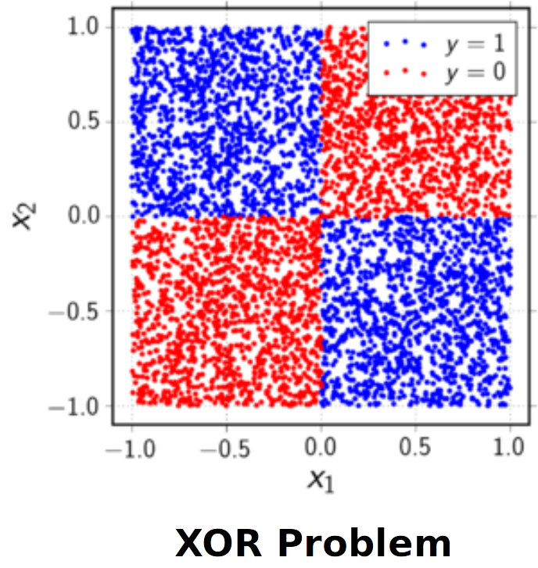
Limitations of Linear Single Layer Classifiers

Slide 35
Limitations of Linear Single Layer Classifiers
Possible Solutions
Add more layers (deep learning)
Map into another (higher dimensional) space
We need to be able to automatically extract features

Slide 36
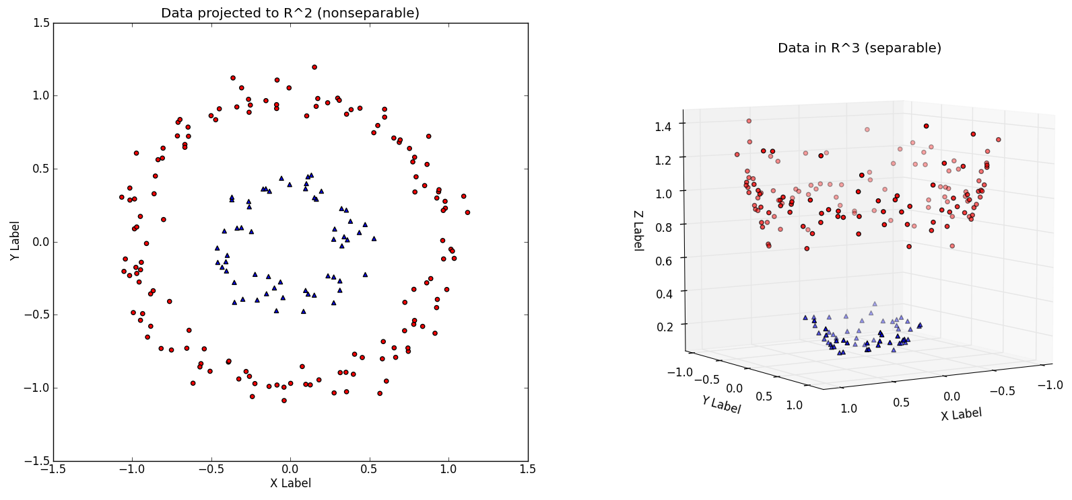
Limitations of Linear Single Layer Classifiers

Slide 37
Universal Approximation Theorem
“
A neural network with a single hidden layer of sufficient size
Can approximate any continuous function

Slide 38
Universal Approximation Theorem
There exists a true function relating the inputs to the outputs
A neural network can approximate this function to arbitrary precision given sufficient layer size
The required layer size can be extremely large and grow rapidly with the dimensionality of the problem
“
A neural network with a single hidden layer of sufficient size
Can approximate any continuous function

Slide 39
Universal Approximation Theorem
There exists a true function relating the inputs to the outputs
A neural network can approximate this function to arbitrary precision given sufficient layer size
The required layer size can be extremely large and grow rapidly with the dimensionality of the problem
“
A neural network with a single hidden layer of sufficient size
Can approximate any continuous function
Use of multiple hidden layers makes the NN vector representation of your problem increasingly more abstract
How do we train?
Compute grows (almost) exponentially

Slide 40

Activation Functions
One of the reasons that enable NNs to encode highly abstract features is the use of non-linear activation functions.
Not using non-linearities leads to linear networks

Slide 41
Activation Functions
One of the reasons that enable NNs to encode highly abstract features is the use of non-linear activation functions.
Not using non-linearities leads to linear networks

Slide 42
Activation Functions
One of the reasons that enable NNs to encode highly abstract features is the use of non-linear activation functions.
Not using non-linearities leads to linear networks
Probability Estimate
Continuously differentiable
Vanishing derivatives due to saturated neurons

Slide 43
Activation Functions
One of the reasons that enable NNs to encode highly abstract features is the use of non-linear activation functions.
Not using non-linearities leads to linear networks
Probability Estimate
Continuously differentiable
Vanishing derivatives due to saturated neurons

Slide 44
Activation Functions
One of the reasons that enable NNs to encode highly abstract features is the use of non-linear activation functions.
Not using non-linearities leads to linear networks
Probability Estimate
Continuously differentiable
Vanishing derivatives due to saturated neurons
Very cheap to compute
Piece-wise linear functions
Dead neurons
Not differentiable at 0

Slide 45
Activation Functions
One of the reasons that enable NNs to encode highly abstract features is the use of non-linear activation functions.
Not using non-linearities leads to linear networks
Probability Estimate
Continuously differentiable
Vanishing derivatives due to saturated neurons
Very cheap to compute
Piece-wise linear functions
Dead neurons
Not differentiable at 0
Activation functions are applied to the output of each neuron (point-wise)
Simple derivative
Non-linear behaviour

Slide 46
Activation Functions
One of the reasons that enable NNs to encode highly abstract features is the use of non-linear activation functions.
Not using non-linearities leads to linear networks
Probability Estimate
Continuously differentiable
Vanishing derivatives due to saturated neurons
Very cheap to compute
Piece-wise linear functions
Dead neurons
Not differentiable at 0
Activation functions are applied to the output of each neuron (point-wise)
Simple derivative
Non-linear behaviour
ReLU made our lives much easier and faster
Most commonly used activation

Slide 47
Activation Functions
One of the reasons that enable NNs to encode highly abstract features is the use of non-linear activation functions.
Not using non-linearities leads to linear networks
Probability Estimate
Continuously differentiable
Vanishing derivatives due to saturated neurons
Very cheap to compute
Piece-wise linear functions
Dead neurons
Not differentiable at 0
Activation functions are applied to the output of each neuron (point-wise)
Simple derivative
Non-linear behaviour
ReLU made our lives much easier and faster
Most commonly used activation
Many more! We can design our own!

Slide 48
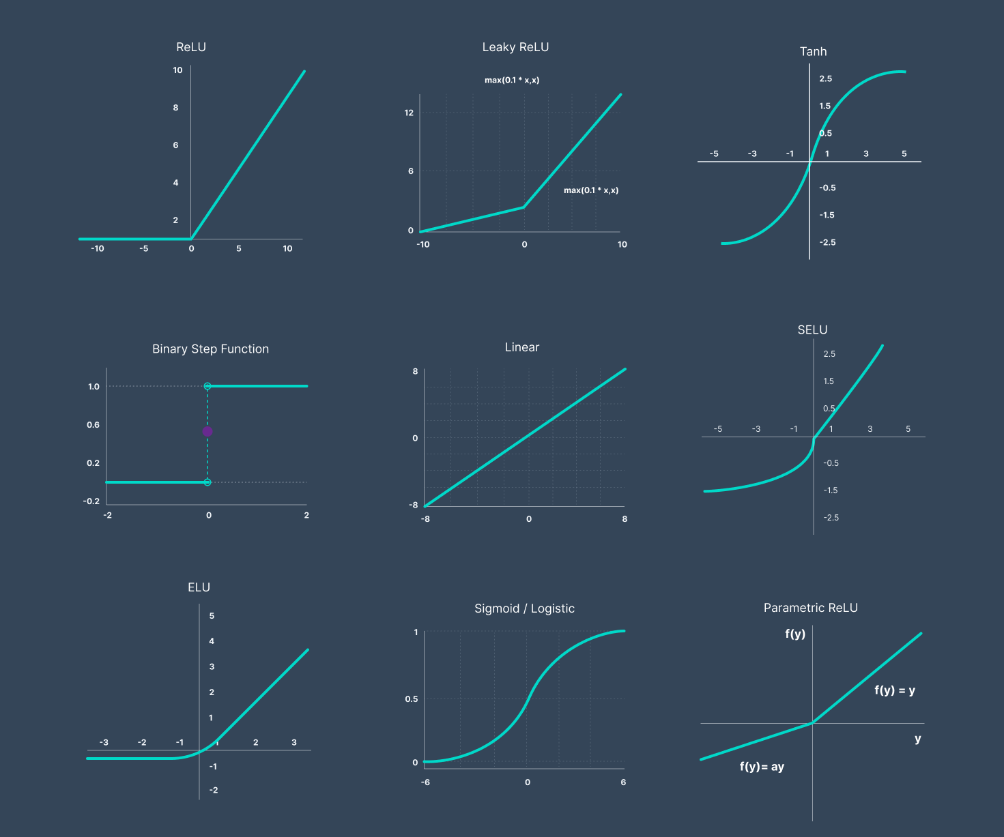
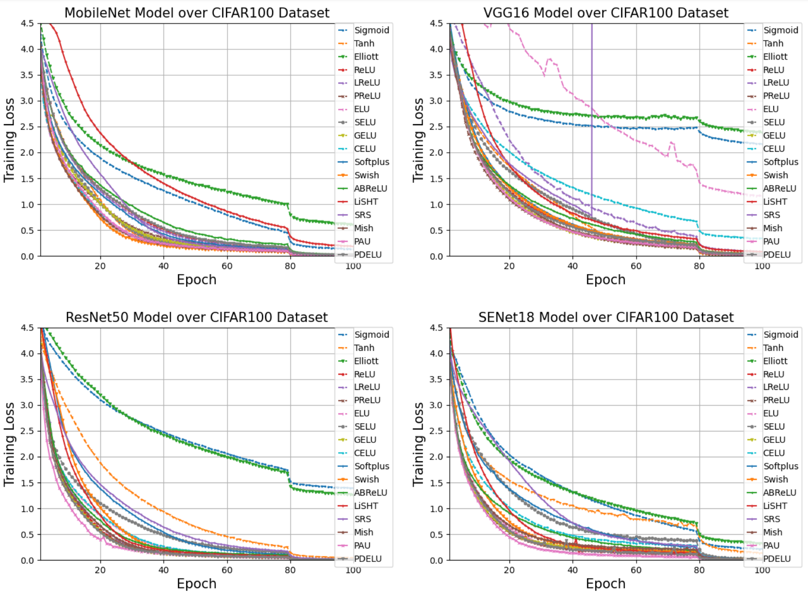
Activation Functions
Many more! We can design our own!

Slide 49
Predicting Housing Price
During the optimization process
The NN learns to encode a representation that maps
the input to the output

Slide 50
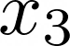
Predicting Housing Price
During the optimization process
The NN learns to encode a representation that maps
the input to the output

Slide 51
Predicting Housing Price
# beds
During the optimization process
The NN learns to encode a representation that maps
the input to the output
Size
Zip-Code
Wealth

Slide 52
Predicting Housing Price
# beds
?
During the optimization process
The NN learns to encode a representation that maps
the input to the output
Size
?
Zip-Code
?
Wealth

Slide 53
Predicting Housing Price
# beds
Family size
During the optimization process
The NN learns to encode a representation that maps
the input to the output
Size
?
Zip-Code
Wealth
School Quality

Slide 54
Predicting Housing Price
# beds
Family size
During the optimization process
The NN learns to encode a representation that maps
the input to the output
Size
?
Zip-Code
Transform the input to a space where we are able to separate the features
Wealth
School Quality

Slide 55
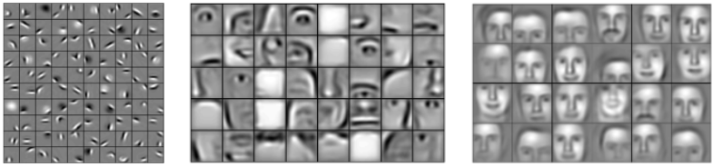
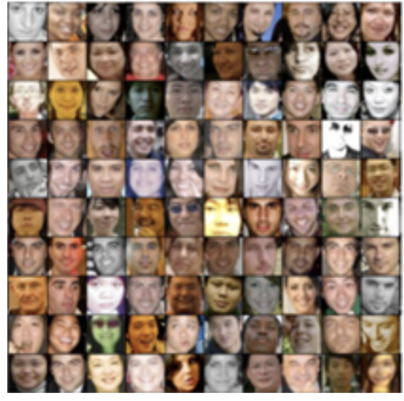
Predicting Faces
During the optimization process
The NN learns to encode a representation that maps
the input to the output
A deep neural network encodes the representation in an increasingly abstract way

Slide 56
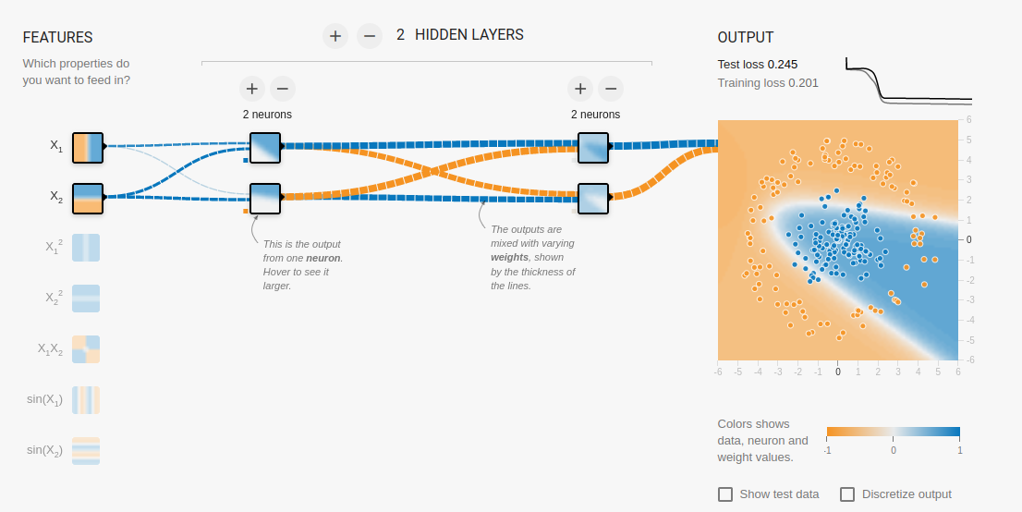
Neural Network Demo
https://playground.tensorflow.org/
SURF

Slide 57
Neural Network
The output of previous layer is used as an input to the next layer
The input layer is data input and the output is a prediction
Anything in between is hidden
Layers are represented as vectors
Edges are matrices
We train the weights

Slide 58
Neural Network Training

Slide 59
Recipe for Training
01.
02.
03.
04.
What function to optimize?
Define the function to approximate
your desired solution
How to evaluate the model?
Which metrics are going to tell us how well we are doing on unseen data?
Process your data
Define the data to be used
Do we have labels?
Define the Model
Define the layers and
The forward propagation

Slide 60
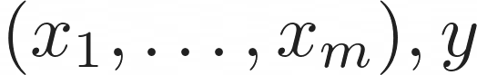
Recipe for Training
01.

Slide 61
Recipe for Training
01.
02.

Slide 62
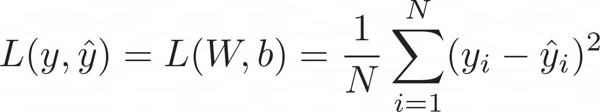
Recipe for Training
01.
02.
03.
MSE

Slide 63
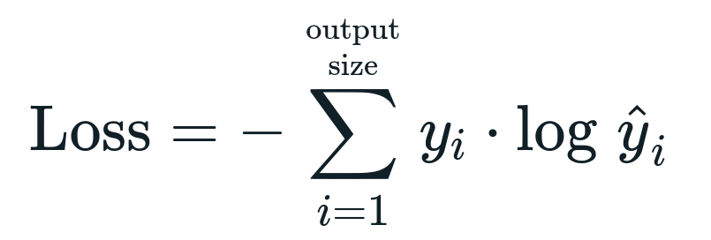
Recipe for Training
01.
02.
03.
MSE
CE

Slide 64
Recipe for Training
01.
02.
03.
04.
MSE
CE
Accuracy, F1-score, precision, recall

Slide 65
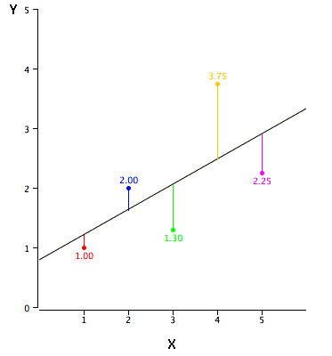
Loss Functions
The loss function is used to bridge the gap between
your neural network predictions and the true value
We optimize (minimize) the loss to tune the weights
In the direction of biggest positive change

Slide 66
Loss Functions
The loss function is used to bridge the gap between
your neural network predictions and the true value
We optimize (minimize) the loss to tune the weights
In the direction of biggest positive change
Distance/statistical metric assumes a Gaussian prior
Easy to understand, easy to
Compute
Prone to outliers
Not suitable for classification
problems

Slide 67
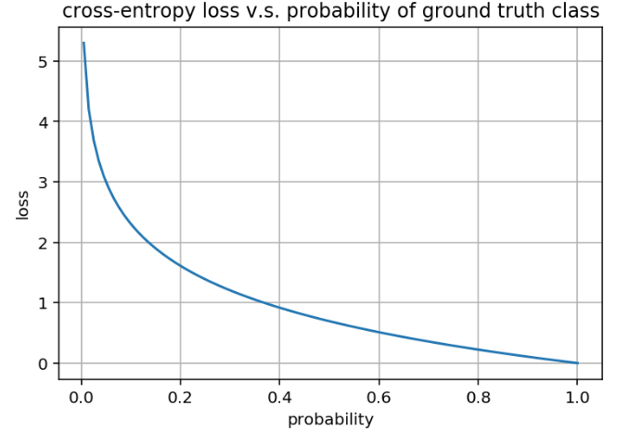
Loss Functions
The loss function is used to bridge the gap between
your neural network predictions and the true value
We optimize (minimize) the loss to tune the weights
In the direction of biggest positive change
Distance/statistical metric assumes a Gaussian prior
Easy to understand, easy to
Compute
Prone to outliers
Not suitable for classification
problems

Slide 68
Loss Functions
The loss function is used to bridge the gap between
your neural network predictions and the true value
We optimize (minimize) the loss to tune the weights
In the direction of biggest positive change
Distance/statistical metric assumes a Gaussian prior
Easy to understand, easy to
Compute
Prone to outliers
Not suitable for classification
problems
Suitable for multi-class
problems
Information theory foundation
Not exactly the most stable loss

Slide 69
Loss Functions
The loss function is used to bridge the gap between
your neural network predictions and the true value
We optimize (minimize) the loss to tune the weights
In the direction of biggest positive change
CE is easily composed with sigmoid
Or Softmax activations!
CE and Softmax has better behaved
gradients.
Non-linear behaviour
Distance/statistical metric assumes a Gaussian prior
Easy to understand, easy to
Compute
Prone to outliers
Not suitable for classification
problems
Suitable for multi-class
problems
Information theory foundation
Not exactly the most stable loss

Slide 70
Loss Functions
The loss function is used to bridge the gap between
your neural network predictions and the true value
We optimize (minimize) the loss to tune the weights
In the direction of biggest positive change
CE is easily composed with sigmoid
Or Softmax activations!
CE and Softmax has better behaved
gradients.
Non-linear behaviour
CE is the negative
log-likelihood
Most commonly used activation for
classification
Distance/statistical metric assumes a Gaussian prior
Easy to understand, easy to
Compute
Prone to outliers
Not suitable for classification
problems
Suitable for multi-class
problems
Information theory foundation
Not exactly the most stable loss

Slide 71
Loss Functions
The loss function is used to bridge the gap between
your neural network predictions and the true value
We optimize (minimize) the loss to tune the weights
In the direction of biggest positive change
CE is easily composed with sigmoid
Or Softmax activations!
CE and Softmax has better behaved
gradients.
Non-linear behaviour
CE is the negative
log-likelihood
Most commonly used activation for
classification
Distance/statistical metric assumes a Gaussian prior
Easy to understand, easy to
Compute
Prone to outliers
Not suitable for classification
problems
Suitable for multi-class
problems
Information theory foundation
Not exactly the most stable loss
Many more! We can design our own!

Slide 72
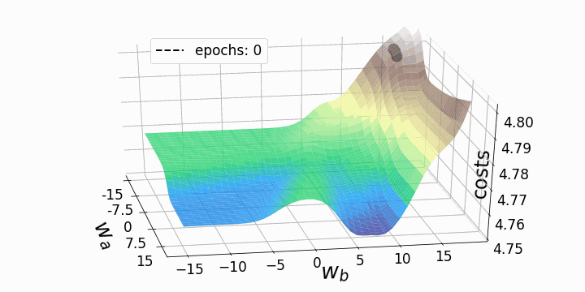
Stochastic Gradient Descent
01.

Slide 73
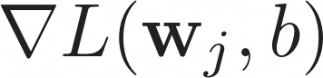
Stochastic Gradient Descent
01.
02.

Slide 74
Stochastic Gradient Descent
01.
02.
Create batches of N examples to propagate
and compute
03.

Slide 75
Stochastic Gradient Descent
01.
02.
Create batches of N examples to propagate
and compute
03.
04.

Slide 76
Stochastic Gradient Descent
01.
02.
Create batches of N examples to propagate
and compute
03.
04.
Learning Rate
Choice of learning rate critical
SGD is the main engine behind training
Many variations exist

Slide 77
Stochastic Gradient Descent
01.
02.
Create batches of N examples to propagate
and compute
03.
04.
Learning Rate
Choice of learning rate critical
SGD is the main engine behind training
Many variations exist
Can be used with loss function that are not differentiable
No Guarantee that we find the global optimum

Slide 78

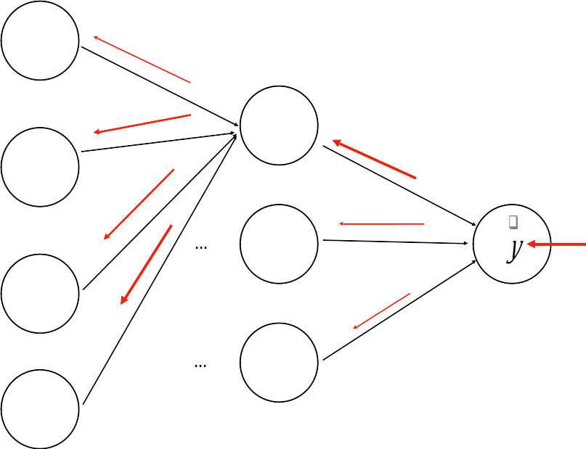
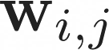
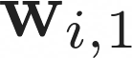
Backpropagation
A (deep) neural network is a deeply nested functions

Slide 79
Backpropagation
A (deep) neural network is a deeply nested functions:
We need to compute the gradient for each layer
Apply the chain rule
This is backpropagation

Slide 80
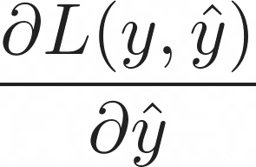
Backpropagation
A (deep) neural network is a deeply nested functions:
We need to compute the gradient for each layer
Apply the chain rule
This is backpropagation

Slide 81
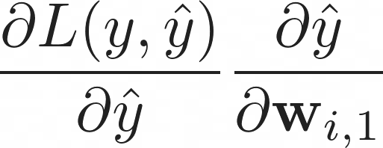
Backpropagation
A (deep) neural network is a deeply nested functions:
We need to compute the gradient for each layer
Apply the chain rule
This is backpropagation

Slide 82
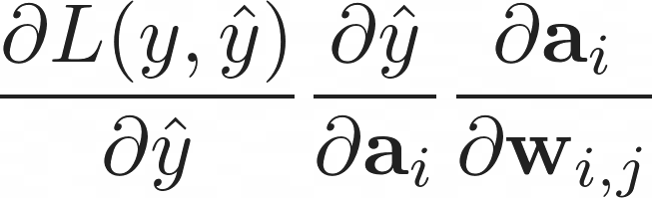
Backpropagation
A (deep) neural network is a deeply nested functions:
We need to compute the gradient for each layer
Apply the chain rule
This is backpropagation

Slide 83

Combatting Overfitting

Slide 84

Combatting Overfitting

Slide 85
Combatting Overfitting
Dropout prior
Weight decay
Early stopping
Batch Normalization

Slide 86
Combatting Overfitting
Dropout prior
Weight decay
Early stopping
Batch Normalization
The more weights we need to train, the more complex the model becomes and the sooner it starts to memorize, if we don’t have enough data

Slide 87

Combatting Overfitting
Dropout prior
Weight decay
Early stopping
Batch Normalization

Slide 88

Combatting Overfitting
Dropout prior
Weight decay
Early stopping
Batch Normalization

Slide 89

Combatting Overfitting
Dropout prior
Weight decay
Early stopping
Batch Normalization

Slide 90
Combatting Overfitting
Dropout prior
Weight decay
Early stopping
Batch Normalization
Models always need regularization no matter how big
Not entirely understood how all these tricks amount to a more complex separating hyperplane

Slide 91

Optimizers
In what way should we change the weights?

Slide 92
ML Workflow
03.
You need to know your data and your models well
Artificial Intelligence still heavily relies on human intelligence

Slide 93

Imbalanced Training set

Slide 94

Imbalanced Training set

Slide 95


Data normalization
A process to transform the input data in a well-behaved form

Slide 96

Open Datasets
Processed, balanced, well-behaved and labelled datasets
tensorflow.org/datasets
kaggle.com/datasets
topepo.github.io/caret/data-sets.html
github.com/awesomedata/awesome-public-datasets

Slide 97

Dataset Splitting
70%
20%
10%

Slide 98


Network Evaluation
Choose an appropriate metric for your own problem
Always sanity check your model, is it better than a baseline?
An almost perfect classification score is always sketchy
Keep questioning the model, never trust it

Slide 99

Workflow

Slide 100
DL Frameworks
04.
Do not compute your own gradients

Slide 101


How to train your NN
Define neurons and layers
Define loss function
Forward propagate and compute loss
Compute gradient
Propagate backward
Update weights

Slide 102
PyTorch and Modularity

Slide 103

Three Levels of Abstraction
Tensor: imperative ndarray, possible to run on GPU/TPU
(node) Variable: Node in the built computational graph; data, gradient storage
(NN) Module: A neural network layer, store the state and the weights of the neural network

Slide 104
Three Levels of Abstraction
Tensor: imperative ndarray, possible to run on GPU/TPU
(node) Variable: Node in the built computational graph; data, gradient storage
(NN) Module: A neural network layer, store the state and the weights of the neural network
X
dot
+
relu
dot
W_1
b_1
W_2
b_2

Slide 105
Three Levels of Abstraction
Tensor: imperative ndarray, possible to run on GPU/TPU
(node) Variable: Node in the built computational graph; data, gradient storage
(NN) Module: A neural network layer, store the state and the weights of the neural network
X
dot
+
relu
dot
+
Exp
W_1
b_1
W_2
b_2
Sum
Div
log
y
dot
neg

Slide 106
Three Levels of Abstraction
Tensor: imperative ndarray, possible to run on GPU/TPU
(node) Variable: Node in the built computational graph; data, gradient storage
(NN) Module: A neural network layer, store the state and the weights of the neural network
X
dot
+
relu
dot
+
Exp
W_1
b_1
W_2
b_2
Sum
Div
log
y
dot
neg

Slide 107
Three Levels of Abstraction
Tensor: imperative ndarray, possible to run on GPU/TPU
(node) Variable: Node in the built computational graph; data, gradient storage
(NN) Module: A neural network layer, store the state and the weights of the neural network
X
dot
+
relu
dot
+
Exp
W_1
b_1
W_2
b_2
Sum
Div
log
y
dot
neg

Slide 108

Three Levels of Abstraction
Tensor: imperative ndarray, possible to run on GPU/TPU
(node) Variable: Node in the built computational graph; data, gradient storage
(NN) Module: A neural network layer, store the state and the weights of the neural network
X
dot
+
relu
dot
+
Exp
W_1
b_1
W_2
b_2
Sum
Div
log
y
dot
neg

Slide 109
Three Levels of Abstraction
Tensor: imperative ndarray, possible to run on GPU/TPU
(node) Variable: Node in the built computational graph; data, gradient storage
(NN) Module: A neural network layer, store the state and the weights of the neural network
X
dot
+
relu
dot
+
Exp
W_1
b_1
W_2
b_2
Sum
Div
log
y
dot
neg
Pytorch will helps us with
Defining a dataset
Automatic Gradient Computation
Defining Neural Networks
Optimization
Scheduling
Distributing

Slide 110

https://pytorch.org/docs/stable/

Slide 111
General Training Structure
data loader
model
optimizer
loss function

Slide 112
General Training Structure
data loader
model
optimizer
loss function
For every datapoint, y in data_loader

Slide 113
General Training Structure
data loader
model
optimizer
loss function
For every datapoint, y in data_loader
optimizer.zero_grad()

Slide 114
General Training Structure
data loader
model
optimizer
loss function
For every datapoint, y in data_loader
optimizer.zero_grad()
prediction = model(datapoint)

Slide 115
General Training Structure
data loader
model
optimizer
loss function
For every datapoint, y in data_loader
optimizer.zero_grad()
prediction = model(datapoint)
loss = loss_function(prediction, y)

Slide 116
General Training Structure
data loader
model
optimizer
loss function
For every datapoint, y in data_loader
optimizer.zero_grad()
prediction = model(datapoint)
loss = loss_function(prediction, y)
loss.backward()

Slide 117
General Training Structure
data loader
model
optimizer
loss function
For every datapoint, y in data_loader
optimizer.zero_grad()
prediction = model(datapoint)
loss = loss_function(prediction, y)
loss.backward()
optimizer.step()

Slide 118

General Training Structure
data loader
model
optimizer
loss function
For every datapoint, y in data_loader
optimizer.zero_grad()
prediction = model(datapoint)
loss = loss_function(prediction, y)
loss.backward()
optimizer.step()

Slide 119
Define Neural Network
Input size of 2
One hidden layer of 8 nodes
1 output node (binary)
Data:
d_1 = [0.9, -0.2], y = 0
d_2 = [0.75, 0.6],y = 1

Slide 120
Define Neural Network
Input size of 2
One hidden layer of 8 nodes
1 output node (binary)
Data:
d_1 = [0.9, -0.2], y = 0
d_2 = [0.75, 0.6],y = 1
Learning rate = 0.01
Optimizer = Stochastic Gradient Descent
Loss = Binary Cross Entropy

Slide 121
Define Neural Network
Input size of 2
One hidden layer of 8 nodes
1 output node (binary)
Data:
d_1 = [0.9, -0.2], y = 0
d_2 = [0.75, 0.6],y = 1
Learning rate = 0.01
Optimizer = Stochastic Gradient Descent
Loss = Binary Cross Entropy

Slide 122


Define Neural Network
Input size of 2
One hidden layer of 8 nodes
1 output node (binary)
Data:
d_1 = [0.9, -0.2], y = 0
d_2 = [0.75, 0.6],y = 1
Learning rate = 0.01
Optimizer = Stochastic Gradient Descent
Loss = Binary Cross Entropy

Slide 123
09/11/2022
Thank You
High Performance Machine Learning Group

